Slide 1
12.08 Create Your Own Challenge Exam
Recursion, Dividing and Conquering, and Piecewise Functions
By Olga Redko

Slide 2
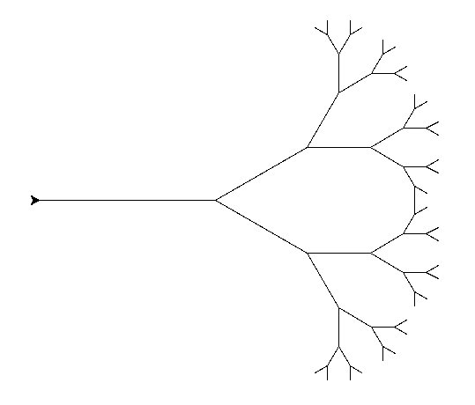
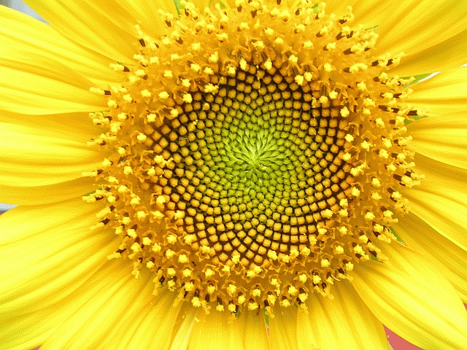
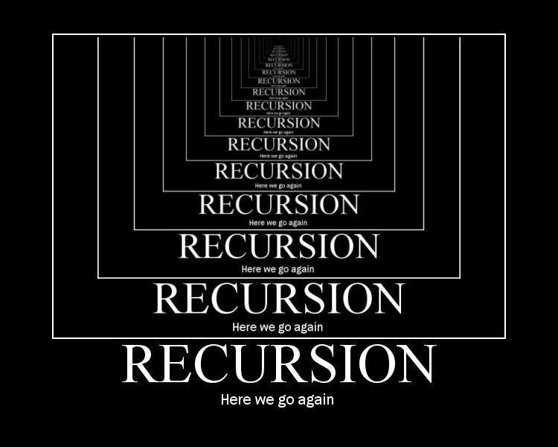
Recursion
Recursion is the process of repeating similar actions that become simpler until a base case is reached. If a base case is not reached, recursion progresses infinitely. An example of recursion is a tree that splits into two branches. These two branches may each split into two more branches, and these new branches may split into two branches again. This process may repeat indefinitely unless a base case, or a real “limit,” is defined.

Slide 3
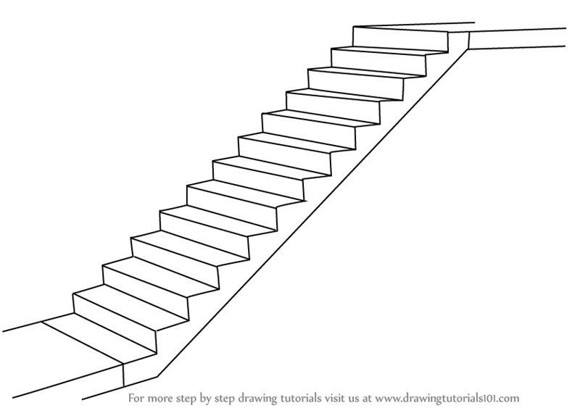

Divide and Conquer
Dividing and conquering is the process of simplifying a complicated problem by dividing the problem into smaller, more manageable steps. For example, if I wanted to reach the second floor of a building, I could easily reach it by climbing up a staircase with small, manageable steps.

Slide 4
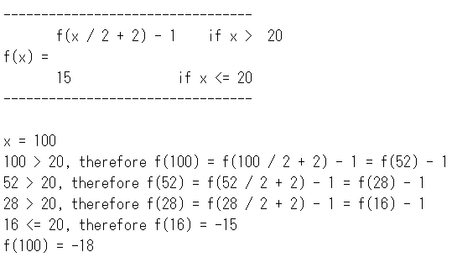
Original Recursive Program
Given the following definition for f(x), evaluate f (100).
f(x/2 + 2) - 1 if x > 20
f(x) = {
15 if x <= 20

Slide 5
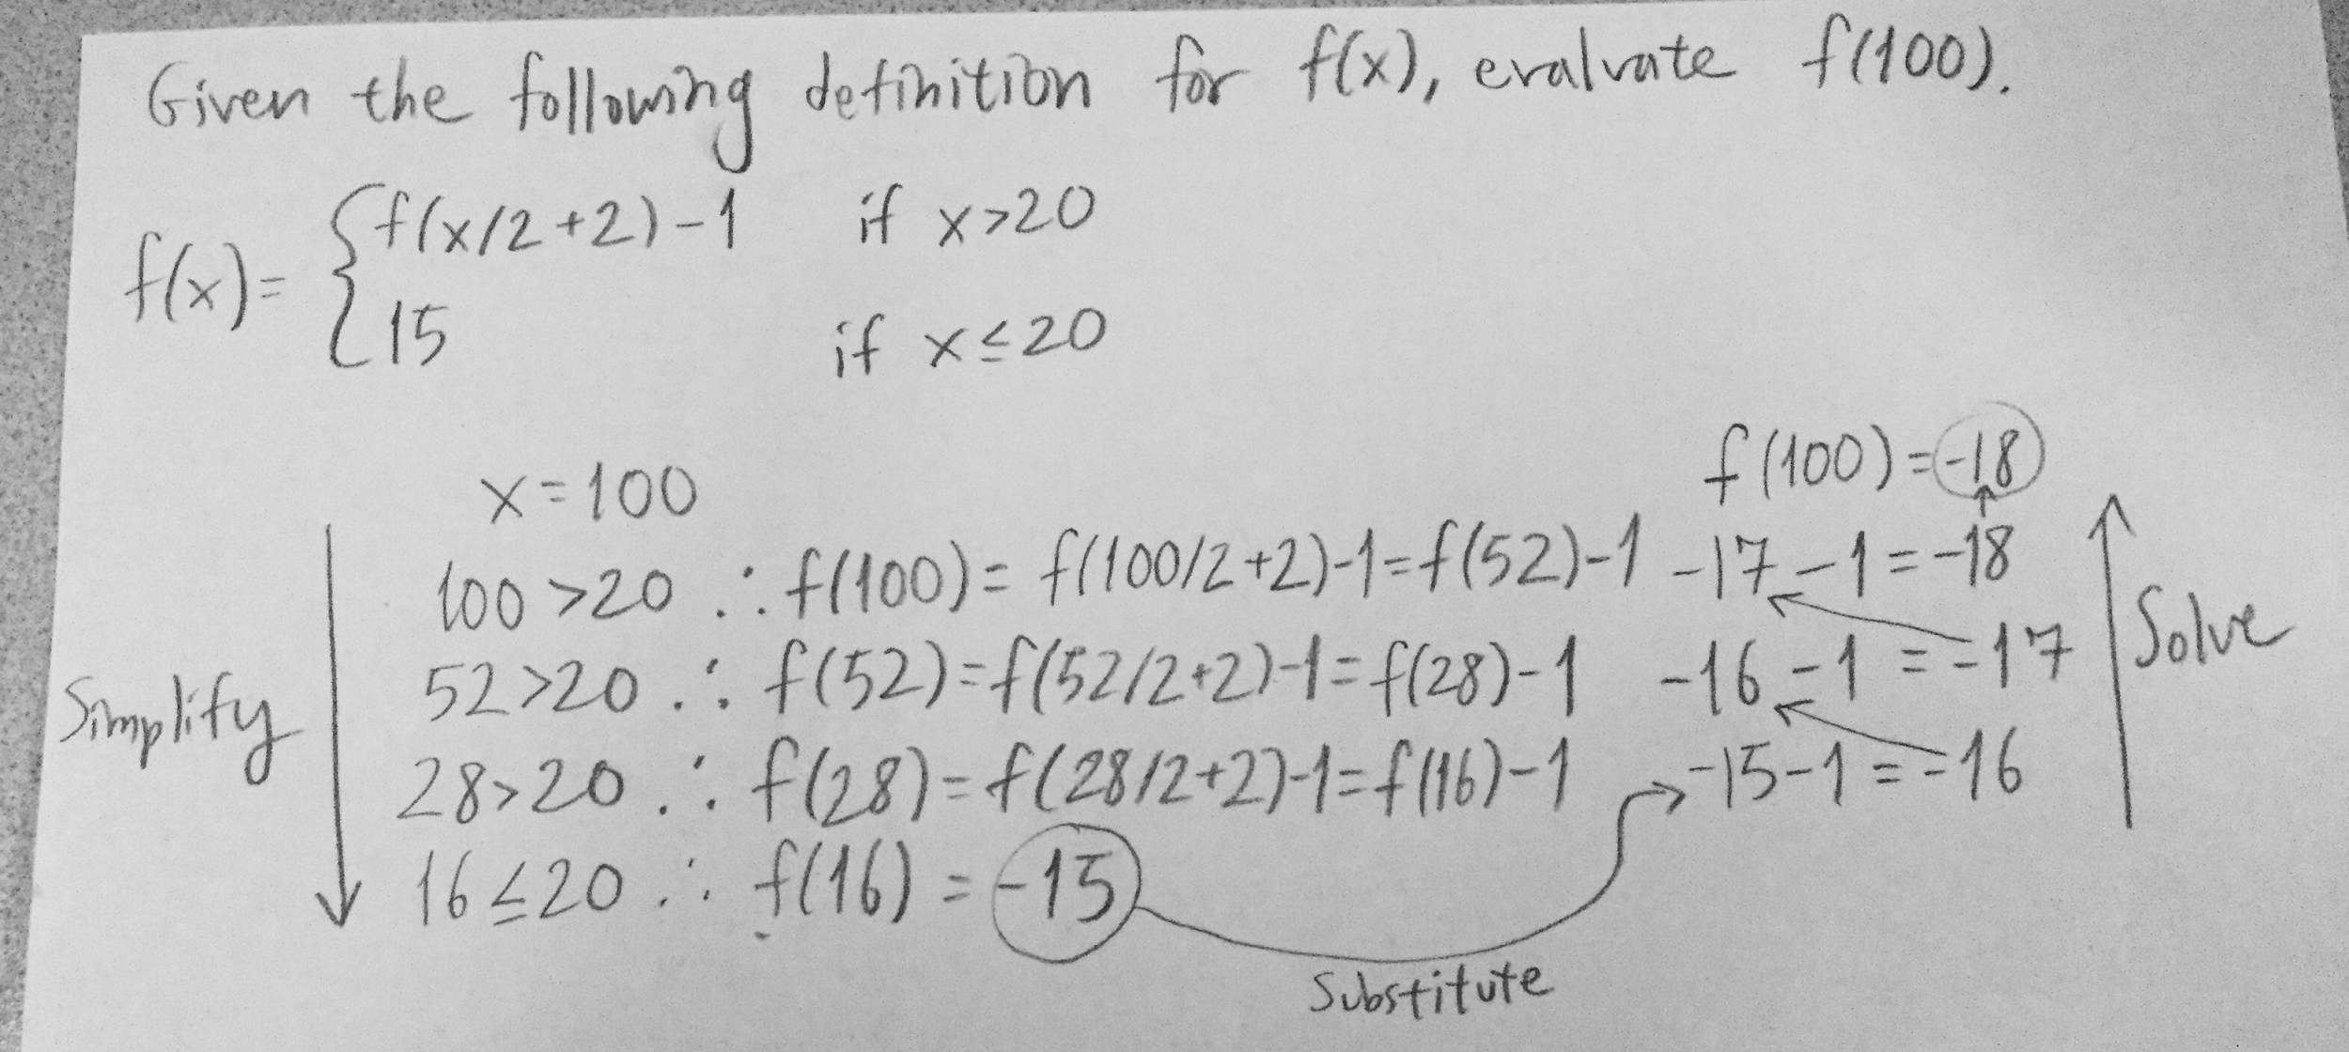
Simplify, Substitute, and Solve Strategy

